Slide 1
Custom Prometheus Exporter to Monitor db2 database In Kubernetes Cluster
CLOUD NATIVE HACKATHON 2020
HCL Confidential

Slide 2
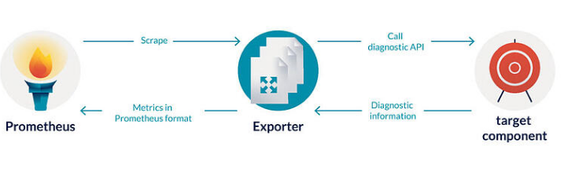
Context
Applications which we want to deploy in Kubernetes cluster do not expose Prometheus metrics out of the box.
In that case exporter is required to retrieve the state / logs / other metric formats of the main service and expose this information as Prometheus metrics.

Slide 3
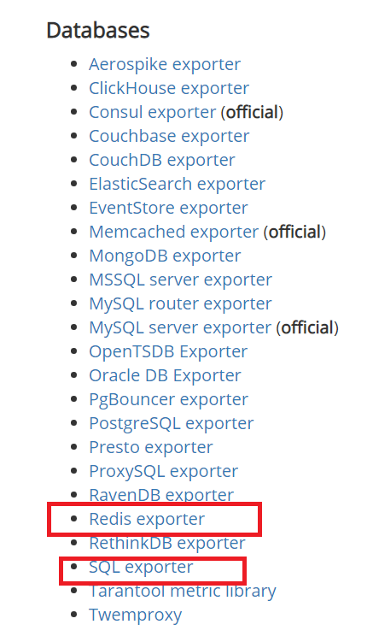
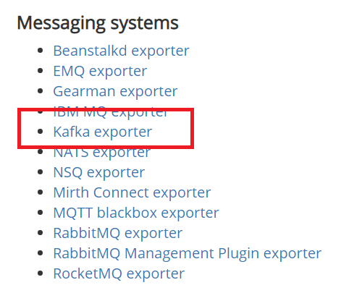

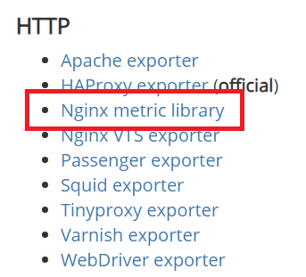
Exporter
A large library of exporters is already available
https://prometheus.io/docs/instrumenting/exporters/

Slide 4
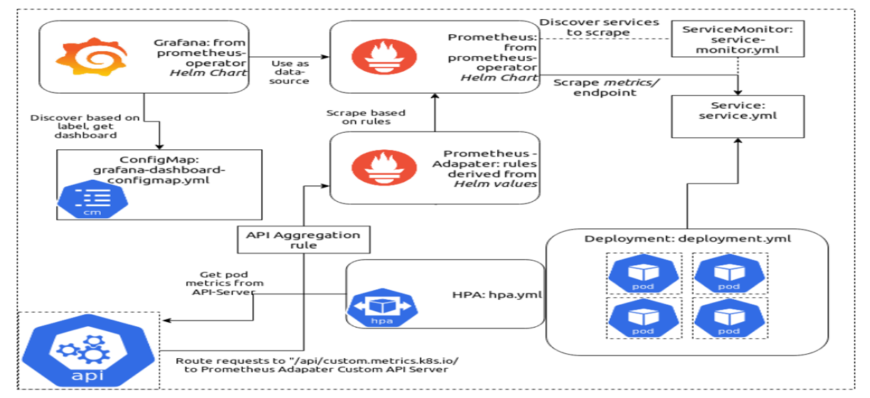
Custom Exporter For Db2 Monitoring
Idea is to write custom prometheus exporter using Kubernetes objects to monitor IBM db2 database.

Slide 5
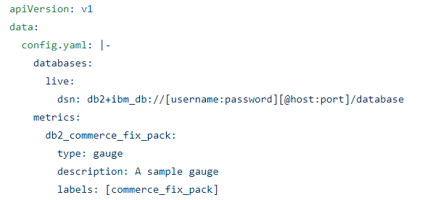
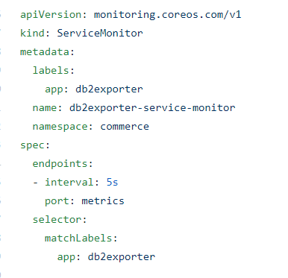
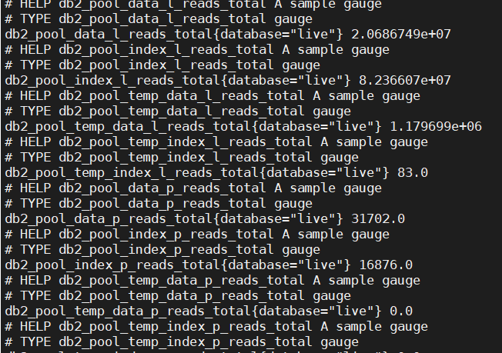
Estimated steps to monitor db2 in K8s
Using query exporter collect metrics from database queries, at specified time intervals.
Write the configuration file (i.e Config Map) contains the definitions of the databases to connect and queries to perform to update metrics.
Service monitor to expose the target endpoints at specific interval.

Slide 6
Business Value

